Slide 1

Credit Card Transaction Analysis
Christin Davis
Xuan Di
Jackson Blanton
Saul Reyes Romero

Slide 2
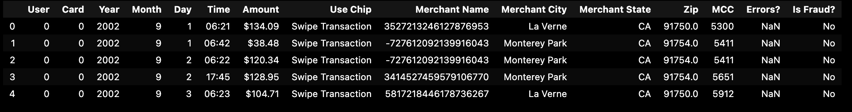
About Our Data
Credit card transactions in csv format
20 million transactions generated from a multi-agent virtual world simulation performed by IBM.
The data covers 2000 (synthetic) consumers resident in the United States, but who travel the world, across 2 decades
Analyses of the data suggest that it is a reasonable match for real data in many dimensions,
Fraud Rates
Purchase Amounts
Merchant Category Codes (MCCs)

Slide 3
MCC Codes
Merchant Category Code
Each credit card provider has their own categories
Categories fall into ranges
MCC codes in this dataset were recoded based on Citi codes
Questions
What does spending look like over time?
How does User0’s spending compare to the dataset as a whole?

Slide 4
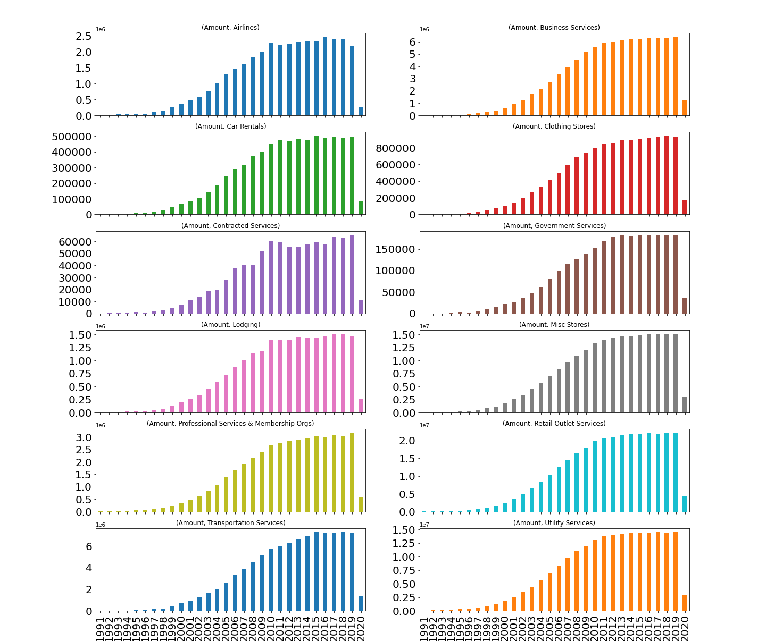
MCC Spending Change Over Time
Notes:
The shape of each graph is roughly the same for all, which indicates an increase in card usage as a form of payment across all categories

Slide 5
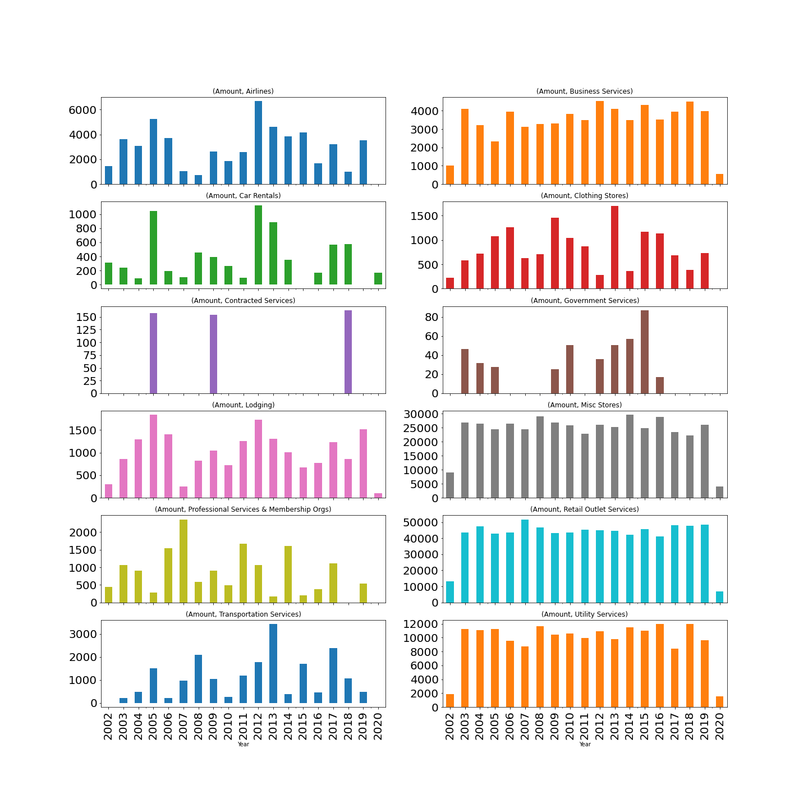
User0’s Spending Habits Over Time

Slide 6
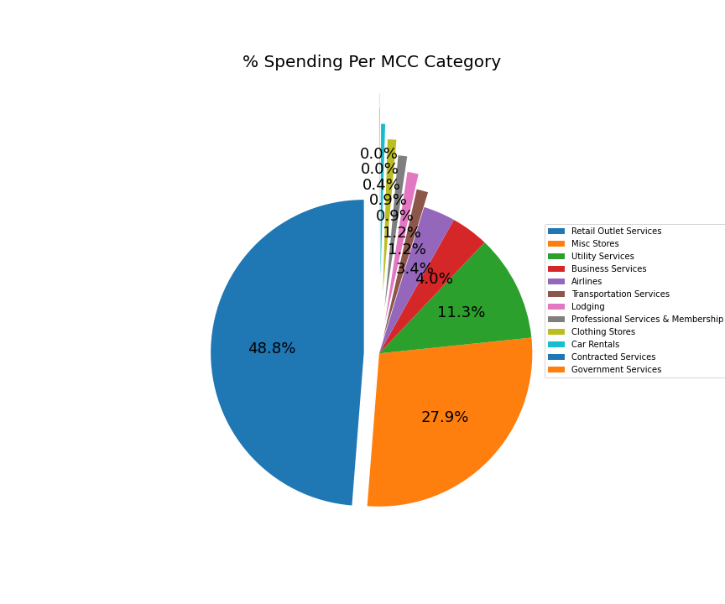
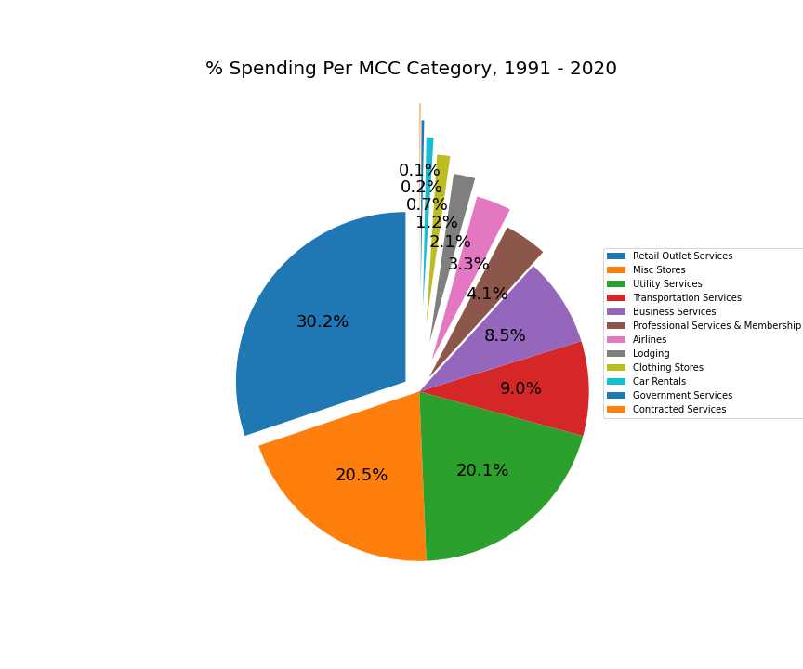
Spending Per Category (All Years)
User0’s Spending Per Category
All User’s Spending Per Category

Slide 7
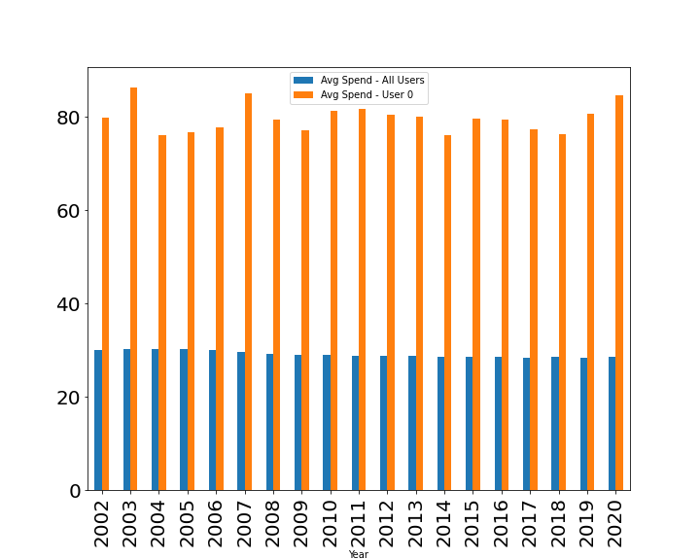
Comparing Average Retail Spend
User0’s retail spend far outpaces the average spend across all other users
Retail spend is fairly consistent across both sets of data

Slide 8

Volume change in transaction types from 2002 to 2020.
The error rate and the fraud rate among swipe, online, and chip transactions.
Transaction Volume, Error Rate and Fraud Rate Analysis

Slide 9
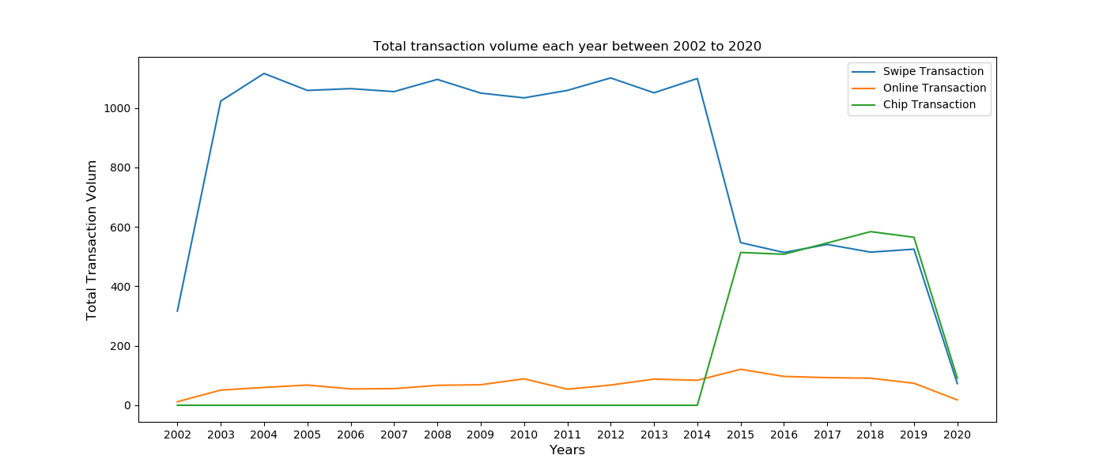
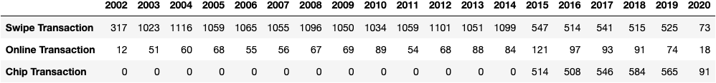
Total Transaction Volume from 2002 to 2020

Slide 10
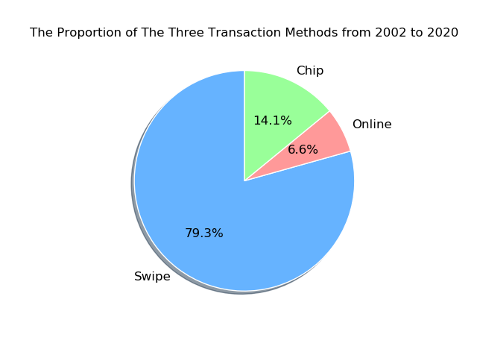
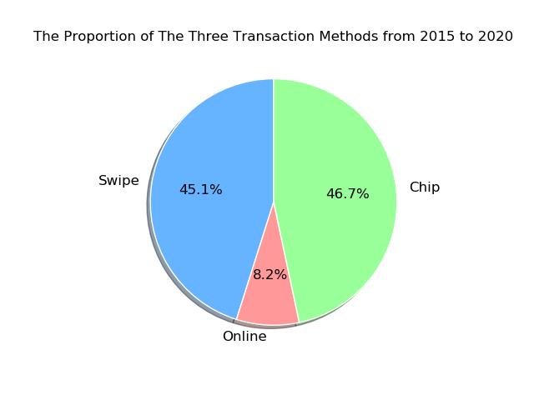

Slide 11
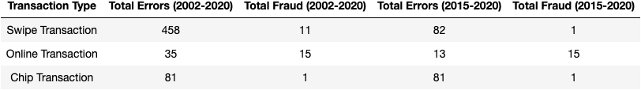
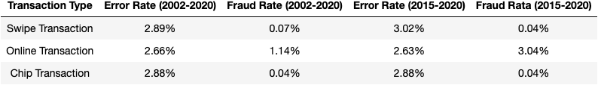
The Error Rate and the Fraud Rate among Swipe, Online, and Chip transactions.

Slide 12
Transaction Volume Analysis
What are the trends in spending over time?
Seasonal differences in transactions
Spikes / dips since 2002

Slide 13
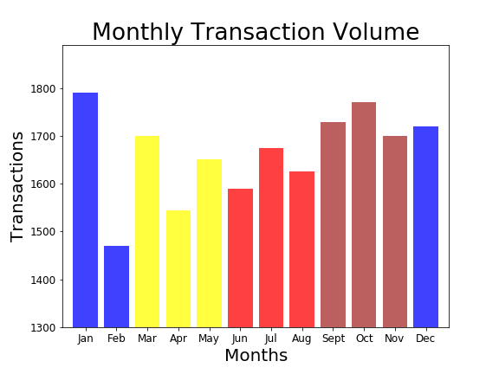
Volume by Month
Spring
mean: 1,631
Standard dev: 78.8
Summer
mean: 1,630
Standard dev: 43.1
Fall
mean: 1,733
Standard dev: 35.8
Winter
mean: 1,660
Standard dev: 168.0

Slide 14
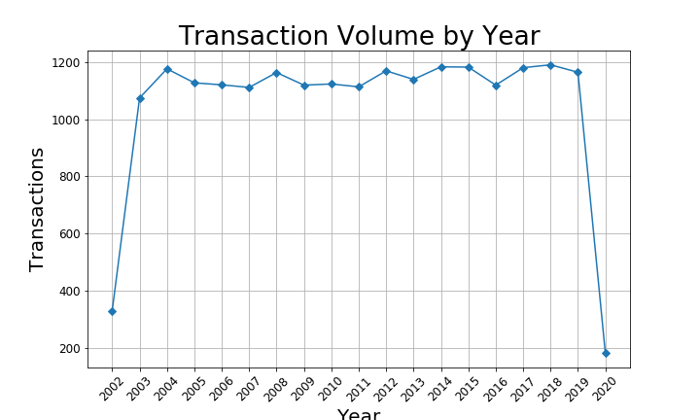
Trends Over the Years

Slide 15
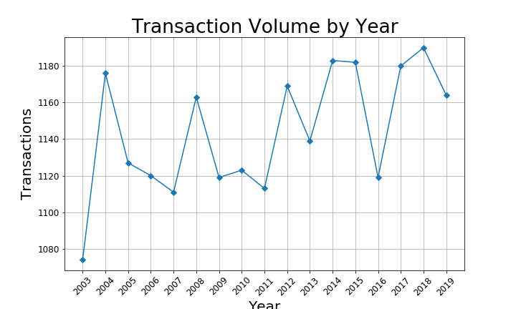
Removing Outliers

